Slide 1
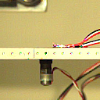
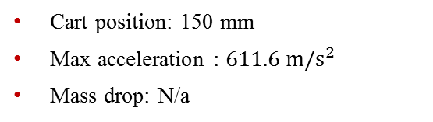
Datasets
High-Rate Overview
Benchmark
Applications
Datasets
Dataset 5 – test 15
Excitations:
Static cart action
Single hammer impact
No electromagnet mass
Cart position: 150 mm
Max acceleration : $611.6 m/s^{2}$
Mass drop: N/a

Slide 2

Datasets
High-Rate Overview
Benchmark
Applications
Datasets
Dataset 5 – test 16
Excitations:
Static cart action
Single hammer impact
Electromagnet mass
Cart position: 150 mm
Max acceleration : $485.8 m/s^{2}$
Mass drop: No

Slide 3

Datasets
High-Rate Overview
Benchmark
Applications
Datasets
Dataset 5 – test 16
Excitations:
Static cart action
Single hammer impact
Electromagnet mass
Cart position: 150 mm
Max acceleration : $485.8 m/s^{2}$
Mass drop: No

Slide 4

Datasets
High-Rate Overview
Benchmark
Applications
Datasets
Dataset 5 – test 17
Excitations:
Static cart action
Single hammer impact
Electromagnet mass
Cart position: 150 mm
Max acceleration : $197.8 m/s^{2}$
Mass drop: No

